Slide 1
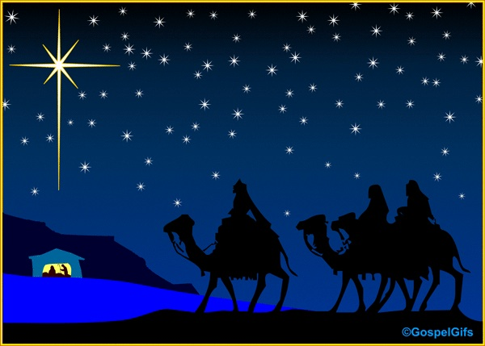
Worship Irony
Matthew 2:1-12
Rick Griffith • Crossroads International Church • BibleStudyDownloads.org

Slide 2
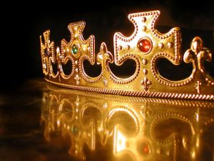
In your small group…
Matthew presents Christ as King of Israel. Do you think Christians today have a hard time thinking of Christ as King?
Why or why not?

Slide 3
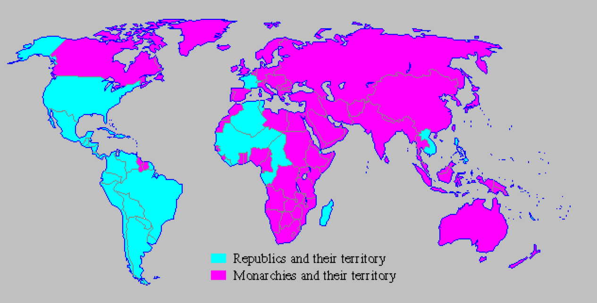
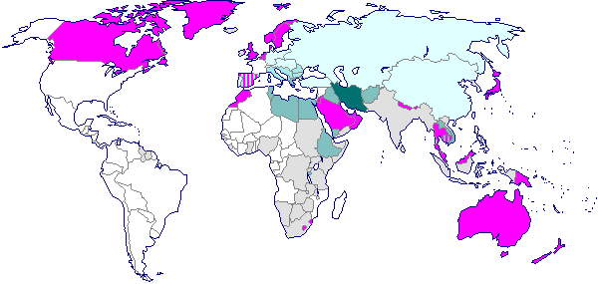
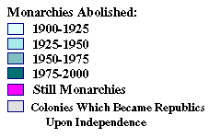
The Demise of Monarchies
Monarchies in 1900
Monarchies in 2000
Notes:
An interesting thing is happening: Monarchies are disappearing (explain).

Slide 4
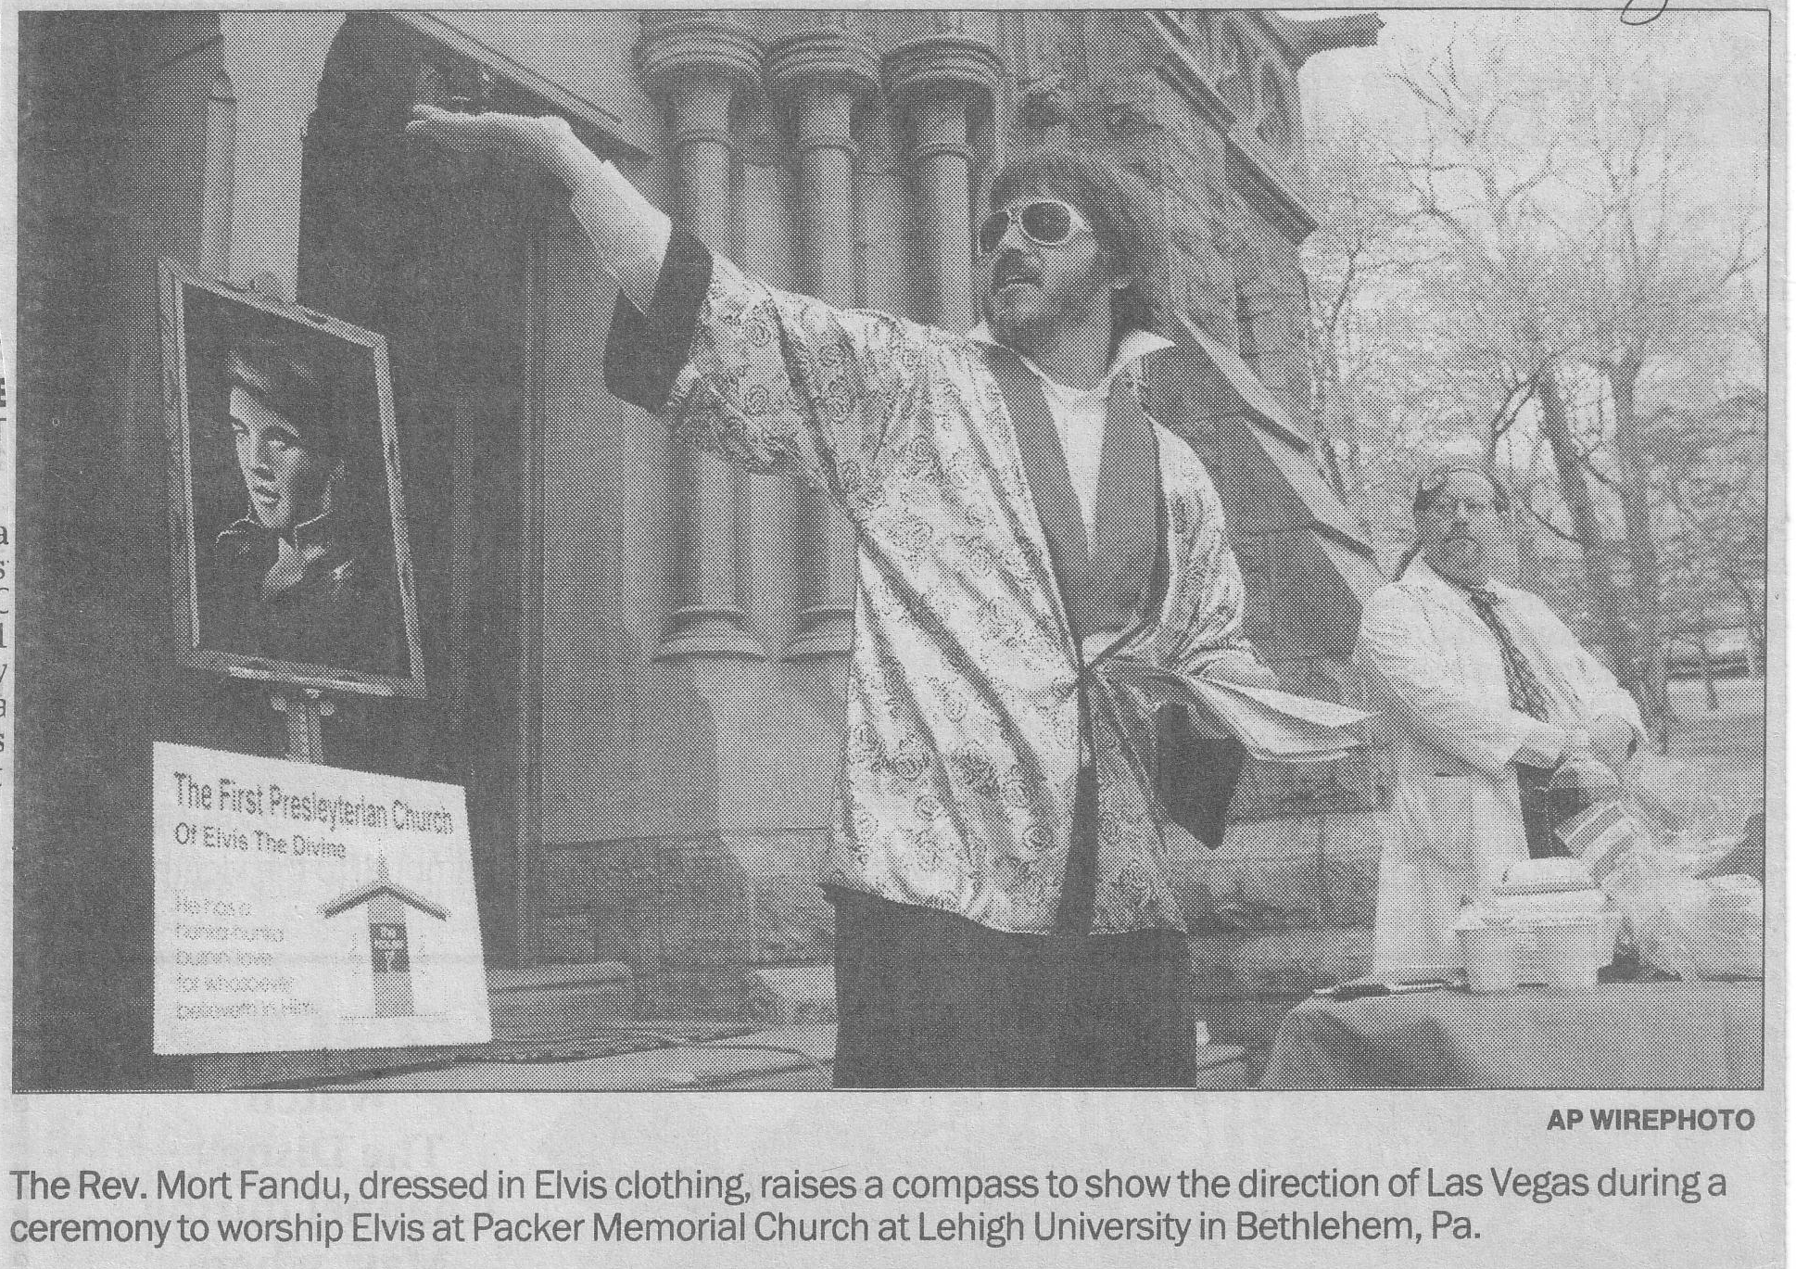
The First Presleyterian Church of Elvis the Divine
The Rev. Mort Fandu, dressed in Elvis clothing, raises a compass to show the direction of Las Vegas during a ceremony to worship Elvis at Packer Memorial Church at Lehigh University in Bethlehem, Pa.
Notes:
The First Preslyterian Church of Elvis the Divine makes it a point to worship “The King” of Rock and Roll.” Wrong king!

Slide 5

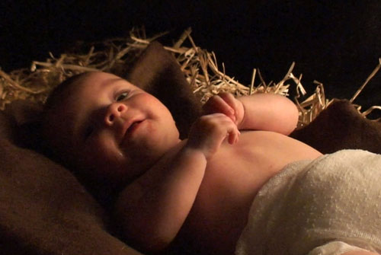
The Newborn King
Notes:
It's that time of the year again when we focus on the Newborn King. The interesting thing is that your speaker today comes from a country that began in rebellion to the idea of kingship and continues to today.
You'll never hear the phrase, "The Kingdom of America"!
The USA has no streets that I've ever seen with these names: Kings Road, Queen Street, and Coronation Road. They just don’t exist in America.
Americans still laugh at all the gossip about Prince Charles, Queen Elizabeth, and the whole royal family.
Unfortunately, America's rebellion towards the idea of kings affects how we look at Christmas. We have a hard time thinking anyone can be king.

Slide 6

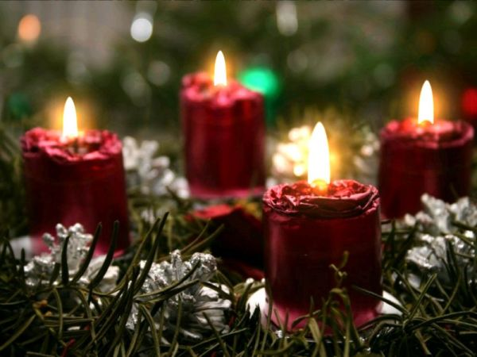
The Meaning of Christmas
Notes:
Actually this can be a problem no matter where you live. Despite the great significance of Jesus being King, attitudes toward Him as King are still mixed today. In fact, they’ve always been mixed even since the first century.
Personally, I love Christmastime. I like the lights, the trees, candles, and reading Christmas cards and getting everyone’s updated pictures!
But for others, Christmas for others is an excuse to get drunk, get something, give a little, leave work, get out of school, spend money, or overeat…

Slide 7
Responses to Christmas
Matthew 2
Notes:
Today we’ll look at some of the responses to the first Christmas in Matthew 2, so I invite you to turn over there. The question we want to answer today is, "How did each of the people noted in this story respond to the birth of this new King?” As we do so we’ll see what we can we learn from how they reacted.
The first people noted in this chapter reveal a very interesting truth…

Slide 8
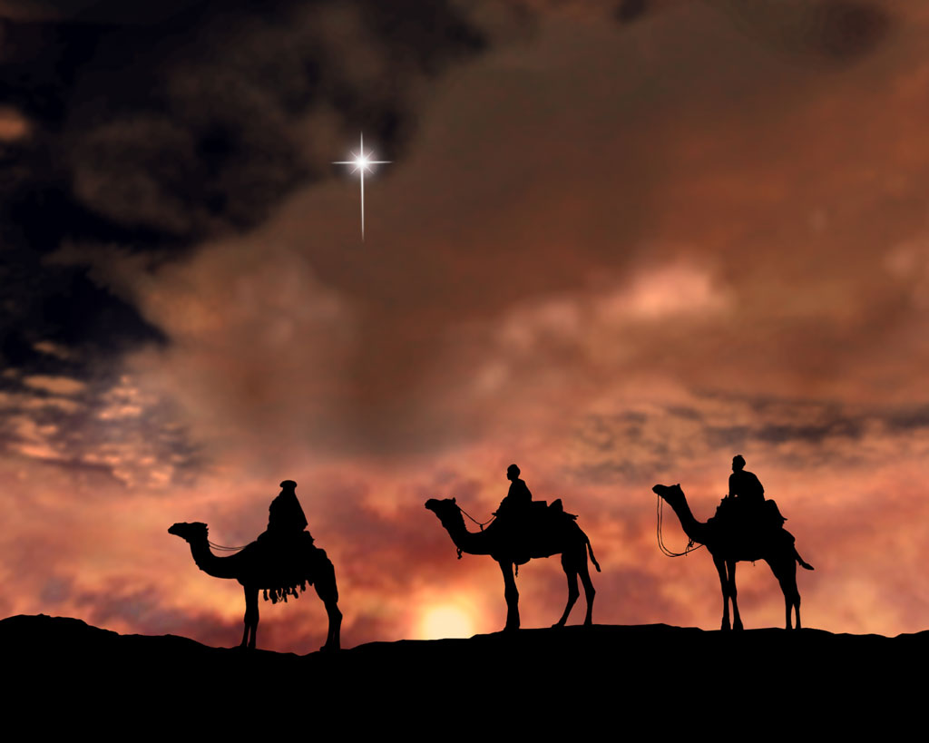
I. Magi whom we wouldn't expect to worship Christ worshipped Him as King (2:1-2).
Notes:
Gentiles who knew very little about Christ gave Him the royal honor He was due.

Slide 9
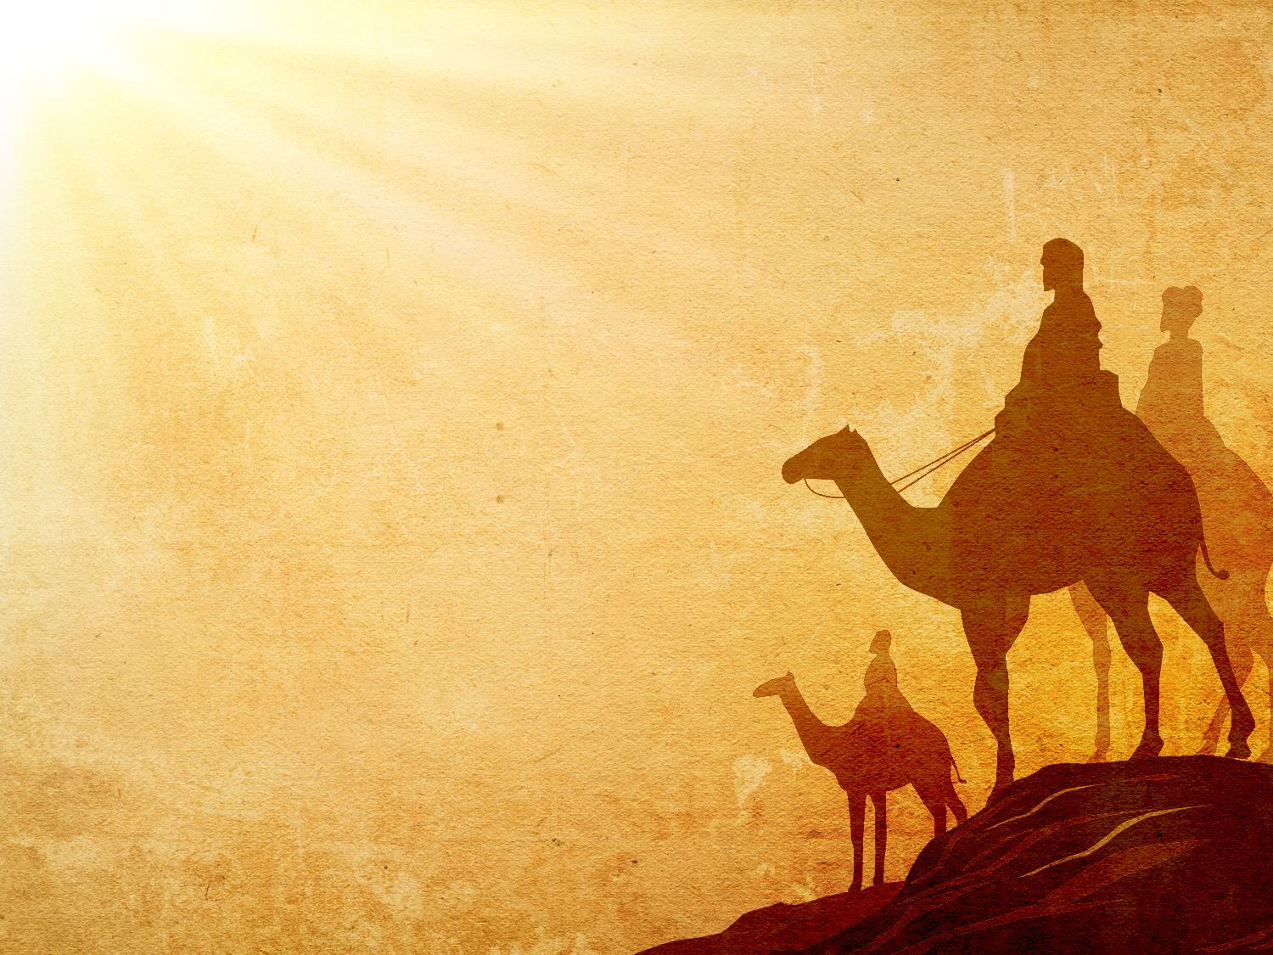
Matt. 2:1-2 NLT
"Jesus was born in Bethlehem in Judea, during the reign of King Herod. About that time some wise men from eastern lands arrived in Jerusalem, asking, ²'Where is the newborn king of the Jews? We saw his star as it rose, and we have come to worship him'"

Slide 10
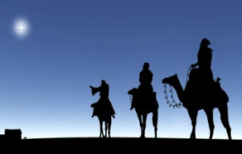
Who were these wise guys?
Notes:
Let's ask and answer some important questions about the magi.
First of all, who were the magi?

Slide 11
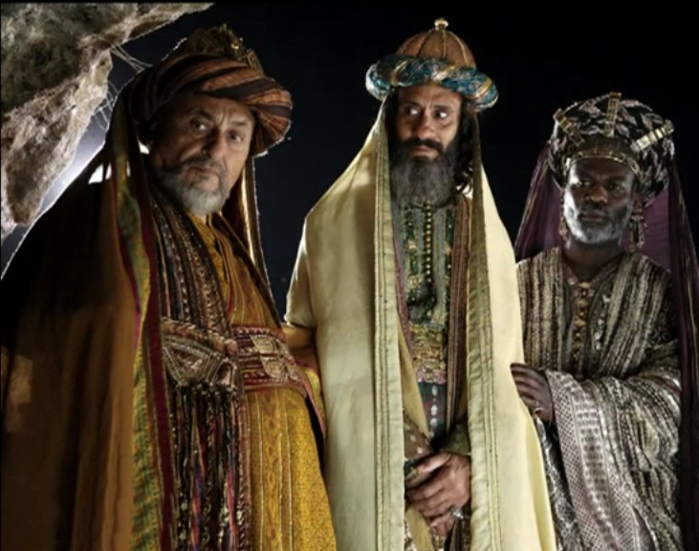
Wise men came from the East
Melchior from Persia
Balthasar from Arabia
Gasper
Notes:
Church tradition claims there were three of them: Balthasar from Arabia, Melchior from Persia, and Gasper (or Casper—the Friendly Wiseman! ☺)

Slide 12
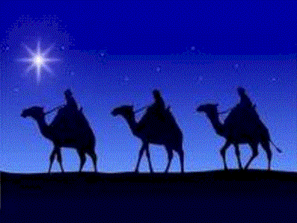
Wise Men from the East
"Magicians" (Dan. 1:20) in Babylon from Media who interpreted dreams
Notes:
Daniel refers to them in his Old Testament book, calling them "magicians" (see Dan 1:20). They were an elite group, a priestly caste who may have been Medes that enjoyed special power to interpret dreams.

Slide 13
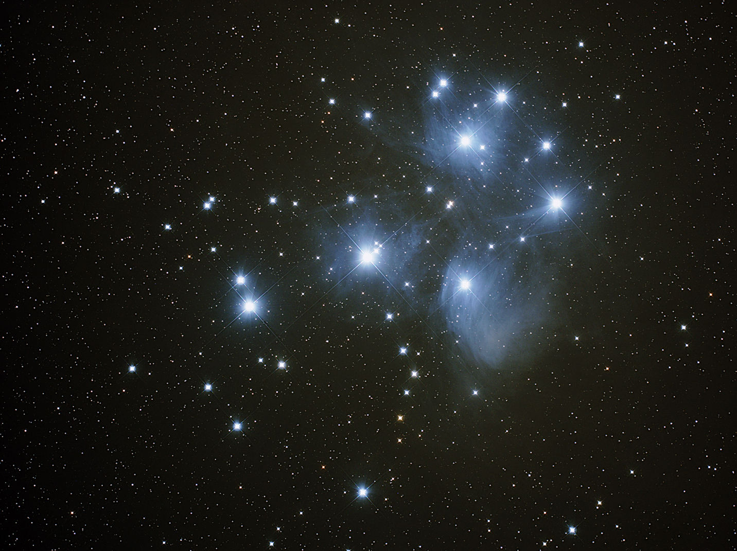
NT Usage
"In later centuries down to NT times, the term loosely covered a wide variety of men interested in dreams, astrology, magic, books thought to contain mysterious references to the future and the like"
(Expositors Bible Commentary)

Slide 14
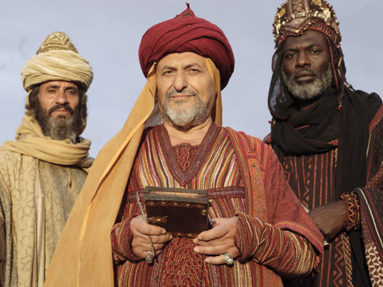
AD 1000
Marco Polo even claimed to have visited their tombs a thousand years after Christ in Iran: "In Persia is the city of Saba, from which the Three Magi set out and in this city they are buried, in three very large and beautiful monuments, side by side. And above them there is a square building, beautifully kept. The bodies are still entire, with hair and beard remaining" (Book i).
Notes:
Apparently they were specialists in astronomy or astrology, depending on whom you read. They were learned men, Gentile men.

Slide 15
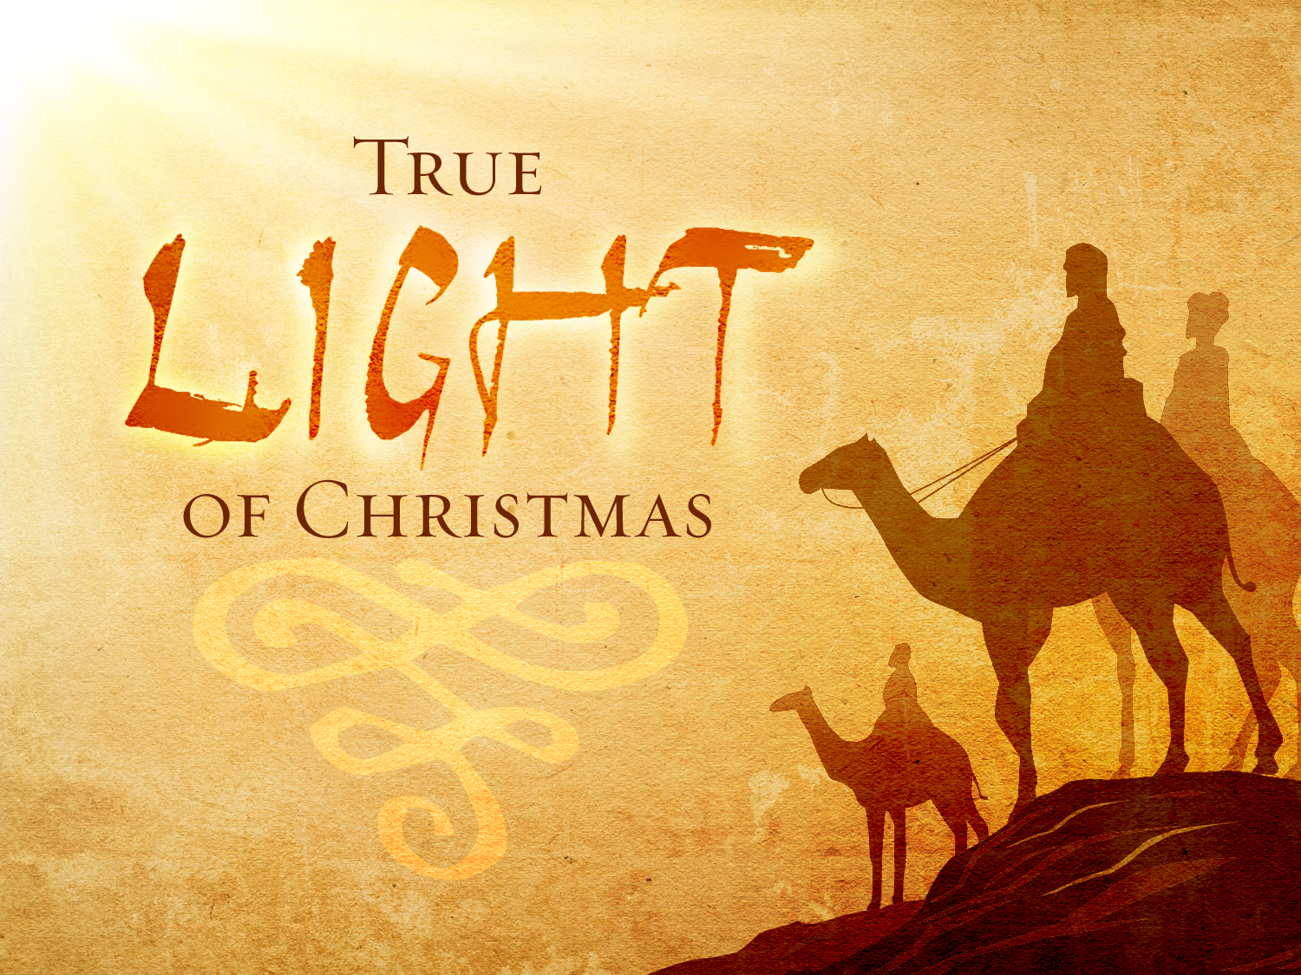
How did they know about the birth of Christ?
Notes:
But how did they know about the birth of Christ?
Evidently, they got a hold of some Old Testament manuscripts, probably from migrating Jewish scholars.
Through their studies they became aware that the King of the Jews would be born in the land of Israel

Slide 16

What kind of star was it?
Notes:
What kind of star was it?

Slide 17
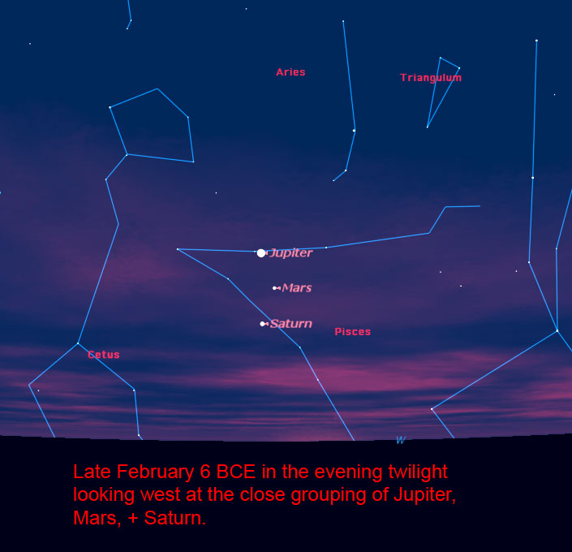
Jupiter + Saturn?
Planet locations in 6 BC
Notes:
Some say it wasn’t actually a star but a configuration of the planets Jupiter and Saturn in a straight line.
The major problem with this is that planets aren't stars—and there is no evidence that ancient people referred to planets as "stars."
Also, further astrological evidence points out that Jupiter and Saturn at closest could be one degree apart—about twice the moon's diameter—so they couldn't have been seen as one image.
Finally, the star moved south to Bethlehem—8 kilometers south of Jerusalem (v. 9). Planets naturally travel east to west across the heavens, not north to south.

Slide 18

Comet, Supernova, Another Planetary Conjunction?
But the text says it was a star!
Notes:
Others claim that what the wise men saw was a comet, a supernova or other planetary conjunctions with Mars or Venus, etc. But the text is clear that it was a star!

Slide 19
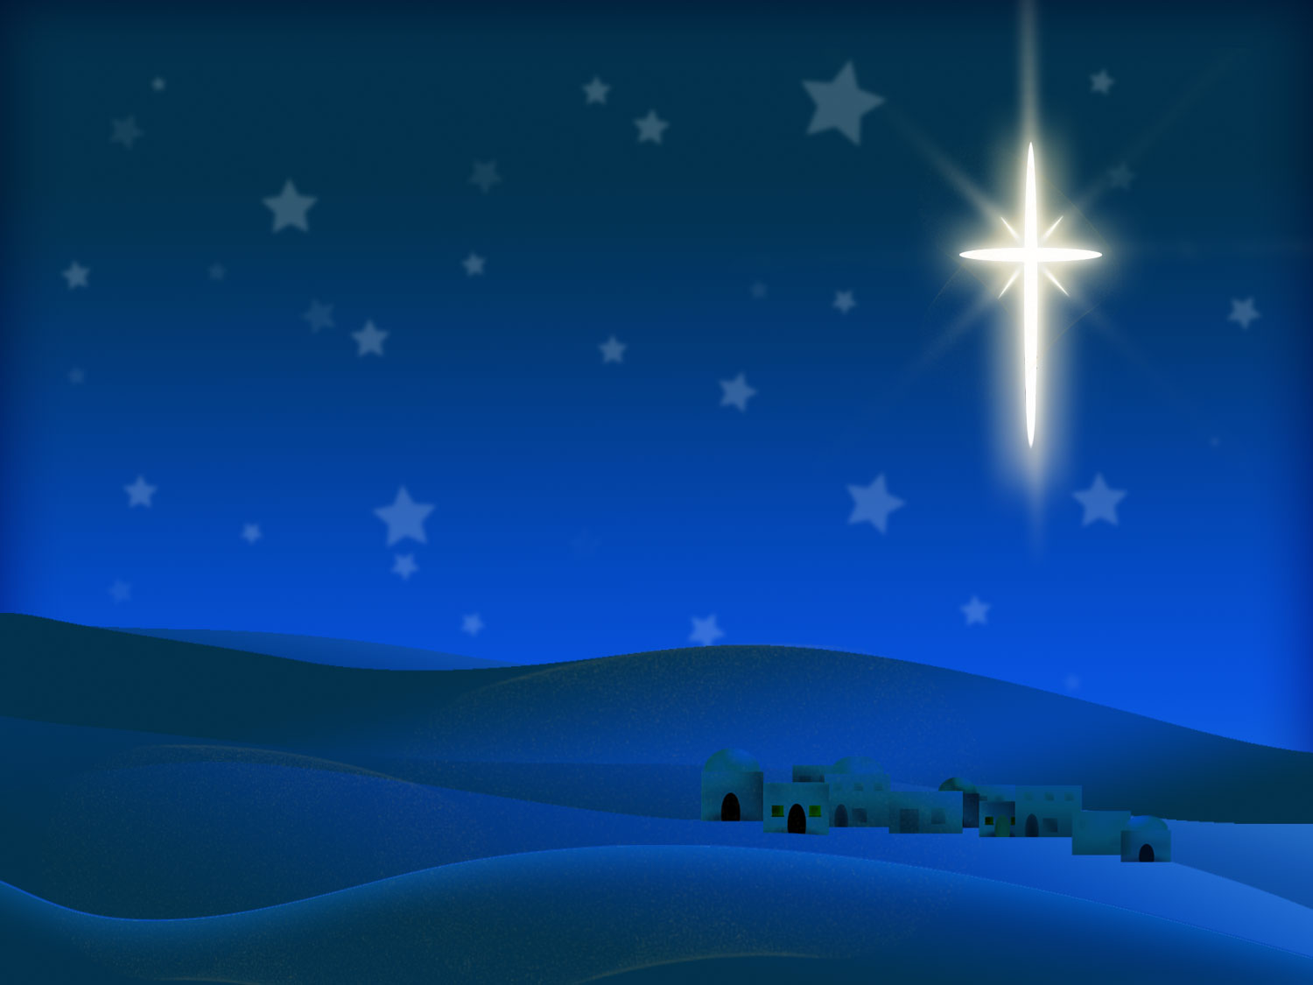
A Miraculous Star
Led to house (2:9)
Seen only by magi
Reappeared (2:10)
Notes:
I think the text teaches that it was not a normal star but a miraculous star.
• Led to house
This star led them so specifically that they came to two particular cities, Jerusalem and Bethlehem—and not only to cities, but the star led the magi to the very house where Christ was staying (v. 9)!
• Only magi saw it
Apparently the magi were the only ones who saw it. Otherwise, the whole region would have been in turmoil!
• Reappear
That the star was a miraculous one is supported in that this star wasn't always visible to the magi because verse 10 indicates that it reappeared to them.
(Let's not miss the forest through the trees with too many details about the magi and the star. The idea here is that…)

Slide 20
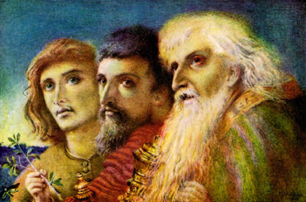
Pagan scholars worshipped the King!
The Point
Notes:
Pagan scholars were worshipping the King.
God specially designed a particular star to guide people who were seeking Him—even though they were Gentiles.
Interesting that Jesus was King of the Jews yet those most open to Him have been those who wouldn’t have expected—Gentiles like you and me.

Slide 21

Is God getting your attention?
Word
Christians
Are you responding?
Notes:
God appointed a special star in their case—What has He been doing in your life to get your attention?
• Word: Has He been showing you truth in His Word to help you turn to Christ?
• Christians: Has He brought some Christians into your life to help you understand what Christianity is all about—that it is a personal relationship with Christ?
• Respond: Have you responded to His guidance? What further evidence do you need

Slide 22
I. Magi whom we wouldn't expect to worship Christ worshipped Him as King (2:1-2).
Notes:
Verses 1-2 tell us that those whom you would never expect to worship Christ ended up looking for Him to worship Him. That's a bit surprising. But you know what's even more surprising than seeing pagans seeking to worship Christ? Observing how those who should worship Him fail to do so! That's what we find in verses 3-8…)

Slide 23

II. Those whom you would expect to worship Christ rejected Him (2:3-8).
Notes:
The very people who should have given Jesus homage turned him down.

Slide 24
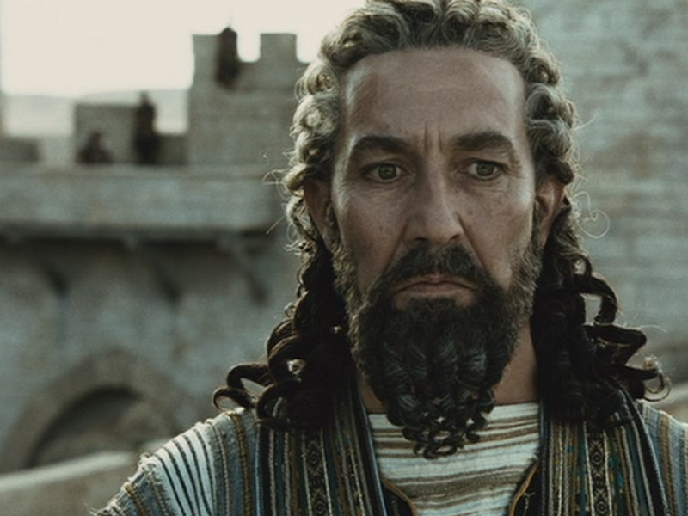
Herod
"King Herod was deeply disturbed when he heard this, as was everyone in Jerusalem"
(2:2 NLT)
Notes:
Why? Jealousy!
He wasn't the rightful king since he wasn't even a Jew, but an Idumean.

Slide 25
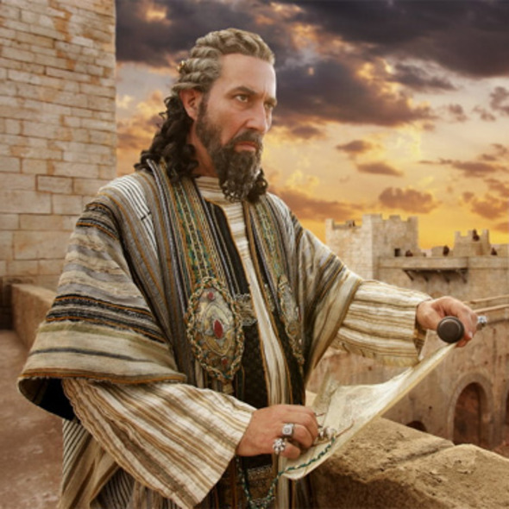
Herod
Notes:
Herod felt threatened that his rule would have to be forfeited, and jealousy in the hands of a man with great power has disastrous results.

Slide 26
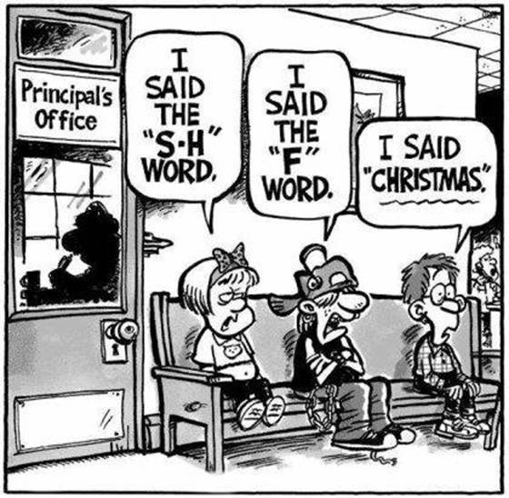
Christmas Shunned
Notes:
Actually many people over the years have rejected Christ’s birth out of jealousy.
This cartoon spoke to me where three kids sit outside the principal’s office. The first says, “I said the S-H word,” the second, “I said the F- word,” and the third, “I said ‘Christmas.’” Yep, some are even trying to outlaw mention of Christmas in the public sector.

Slide 27
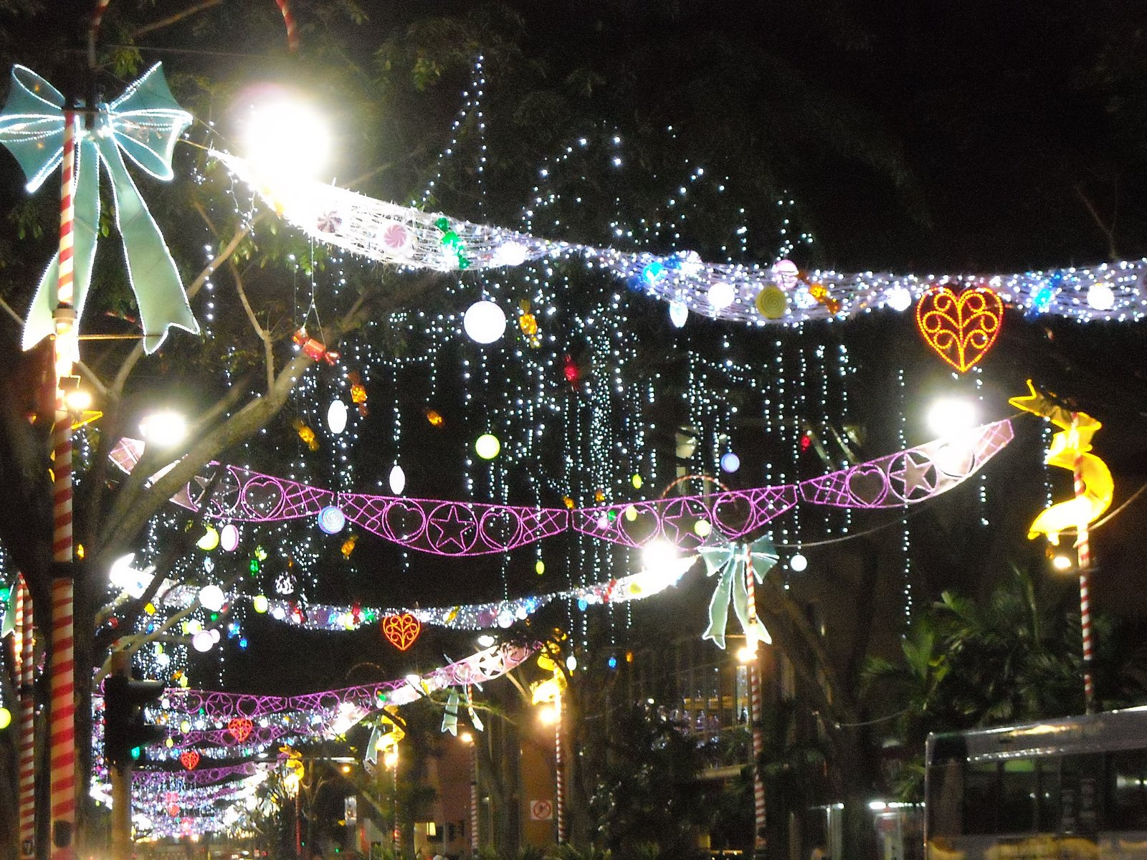
Orchard Road Christmas
Notes:
Today some countries prohibit celebration of Christmas lest it take away devotion to the government or majority religion.
Many companies rely on 25% of their gross sales in December—that’s so much pressure that jealousy for sales can result in rejecting Christ.

Slide 28
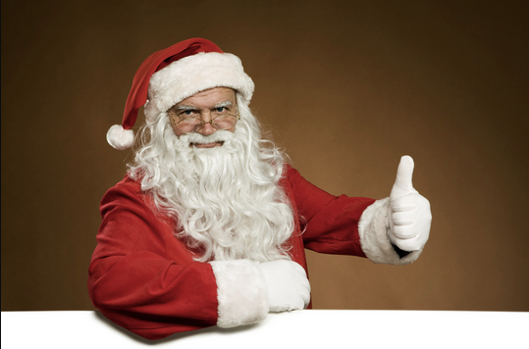
Santa
Notes:
Then, of course, many replace Christ with Santa—

Slide 29
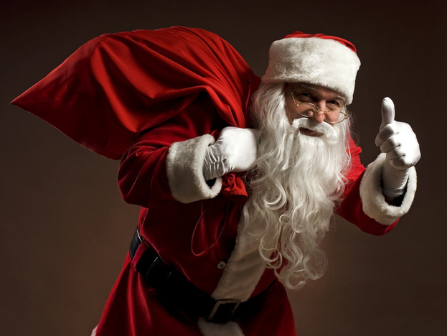
Santa
Notes:
who, when you think about him, though he could be seen threatening, is a really cool guy—

Slide 30
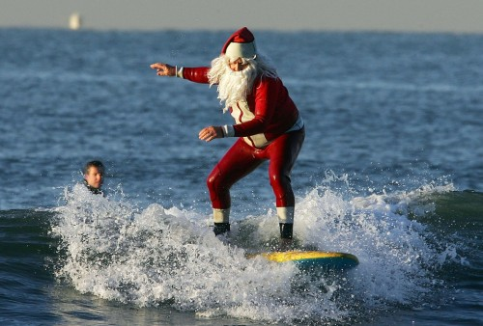
Santa
Notes:
one who can do amazing things—

Slide 31
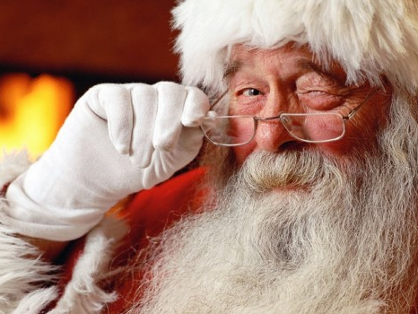
Santa
Notes:
—though not even near to being God like Christ!

Slide 32
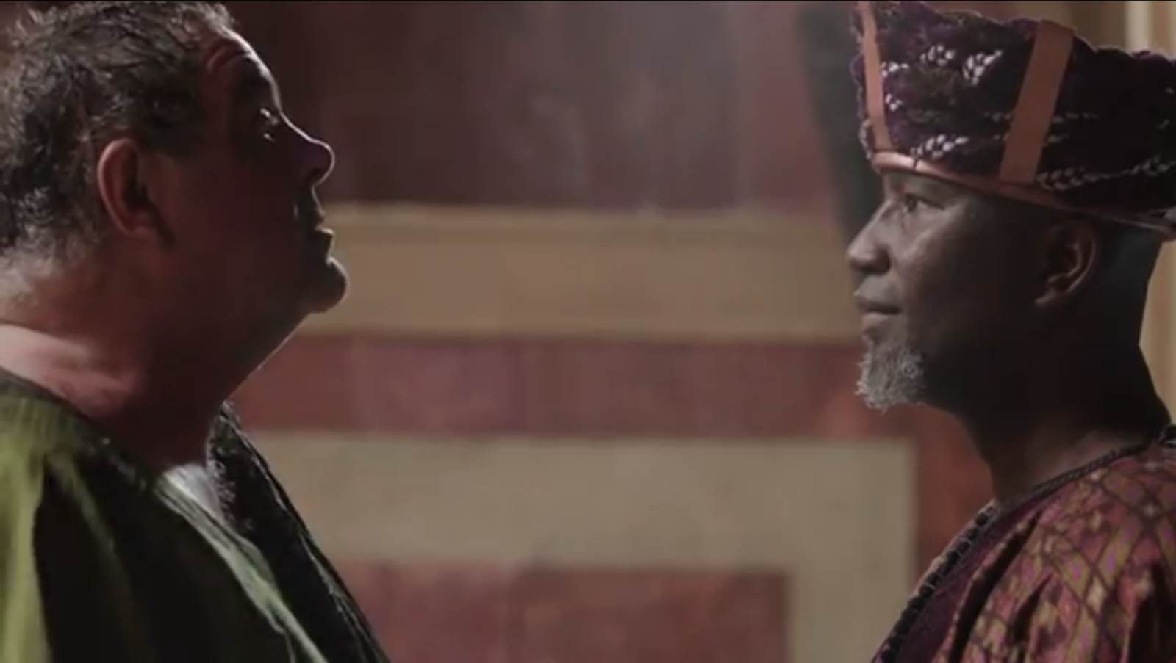
Feeling threatened causes us to reject but…
Notes:
So feeling threatened can move us to reject others and Herod was no exception. But…

Slide 33
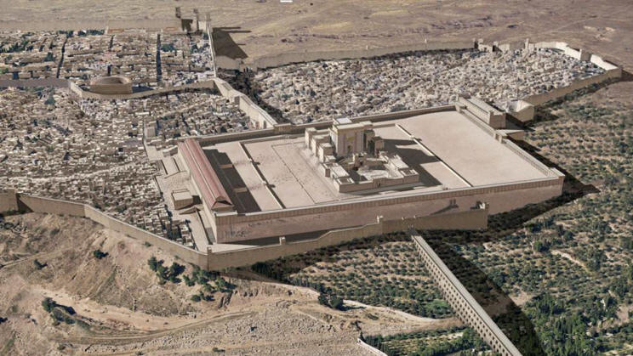
Jerusalem was disturbed
Notes:
Jerusalem was also disturbed about Him (2:3b).

Slide 34
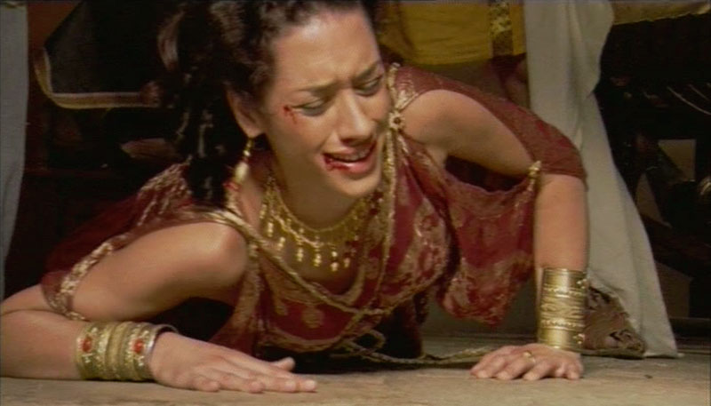
Herod's Wife Mariamne (27 BC)
Notes:
Why? They knew that even the possibility of another king could result in more cruelty from Herod. He had already executed his own wife Mariamne after she bore him five children (27 BC)—and she was his favorite wife! Herod's paranoia led him to murder his two sons, his mother-in-law, brother-in-law, uncle, and many others.

Slide 35
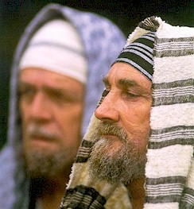
Jerusalem was disturbed
Notes:
For whatever reason, these people in Jerusalem, Jews who were supposed to be anxiously awaiting the coming of their Savior, were upset that He had finally come!

Slide 36

Christmas Stress
Notes:
We also can get disturbed about Christmas, can’t we?

Slide 37

Christmas Stress
Notes:
Our “To-Do” list gets longer—so many cards to write, presents to buy, on and on…

Slide 38

Christmas Stress
Notes:
A Bible teacher who lives in Israel wrote me this email (in 2006):

Slide 39
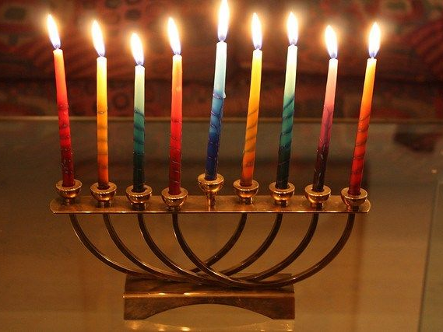
Hanukkah
Notes:
“In Israel this month, the kids get a week off of school for Hanukkah but return to regular classes on Christmas Eve. Christmas is a regular day for businesses and students throughout the Jewish state. This lack of notice is not unlike the situation 2,000 years ago when the Messiah was born: apart from a few shepherds in the field, there was little fanfare.
“In some parts of the world today, Christmas is celebrated as big business and… not centered on the One whose birthday it is. The strategy seems to be that if you can't get them to ignore it, at least get them to distort it” (Todd Bolen, BiblePlaces Newsletter, Vol. 5, #5, 5 Dec 06). And so we end up being disturbed about the birth of the One we really need!

Slide 40

Christmas Stress
Notes:
Women seem to handle the stress better than men—

Slide 41
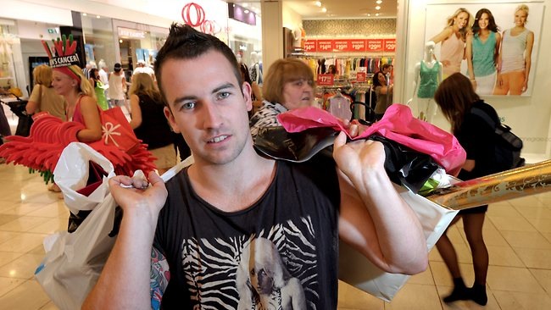
"Christmas Shopping:
Bad for Men"
Notes:
—and some men handle it well—

Slide 42

"Christmas Shopping:
Bad for Men"
Notes:
—but a British psychologist said in 1998 that Christmas shopping is so disturbing for men that they shouldn’t do it.
The December 4 Straits Times article read, “Christmas shopping ‘Bad for Men.’”

Slide 43

Christmas Stress
Notes:
This is why online shopping has increased.

Slide 44
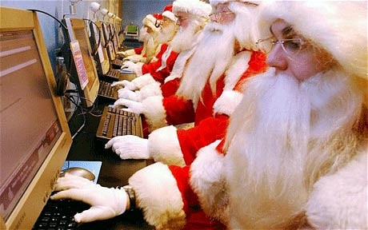
Christmas Stress
Notes:
Even Santa does it.
(The magi were seeking Christ, Herod was opposing Christ, Jerusalem was disturbed about Christ. But what about the Jewish leaders?)

Slide 45
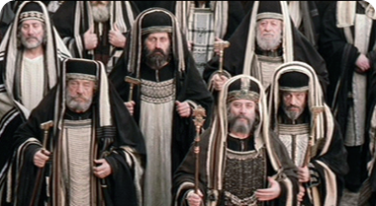
The Jewish leaders ignored Him (2:4-6)

Slide 46
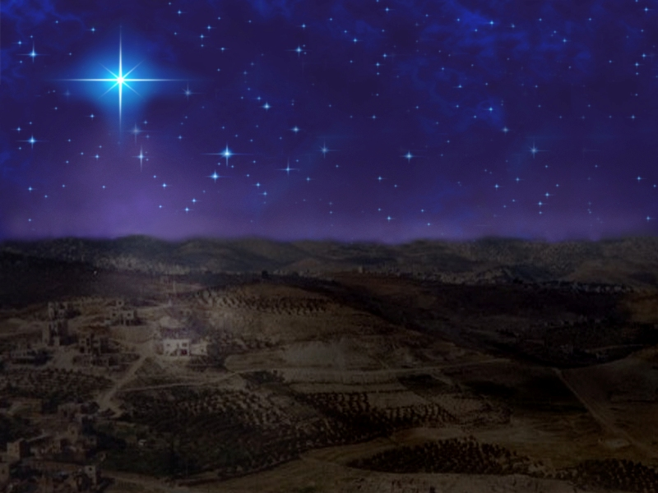
Bethlehem
“And you, O Bethlehem in the land of Judah, are not least among the ruling cities of Judah, for a ruler will come from you who will be the shepherd for my people Israel”
(Micah 5:2 quoted in Matthew 2:6 NLT)
Notes:
The Jewish leaders were sought out for their advice (2:4).
These leaders knew that Christ would be born in Bethlehem (2:5-6).
The leaders paraphrased Micah 5:2 that gives the exact city where the Messiah would be born—in Bethlehem, which was also called "Ephrath" (cf. Gen 35:19).

Slide 47
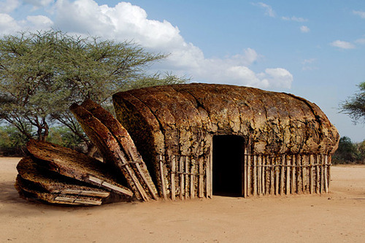

Bethlehem = "House of Bread"
Notes:
Incidentally, "Bethlehem" means "house of bread." How fitting of a place for the very Bread of Life to make His entrance into the world!

Slide 48
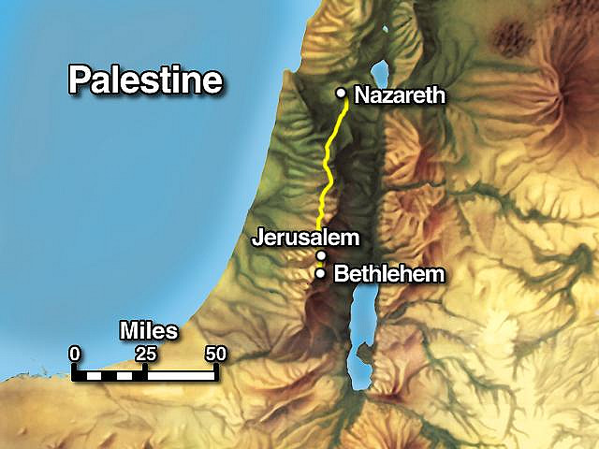
These Jewish leaders never went to see Him themselves!
Notes:
They knew the place but these leaders never went to see Him themselves!

Slide 49
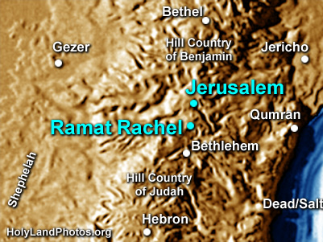
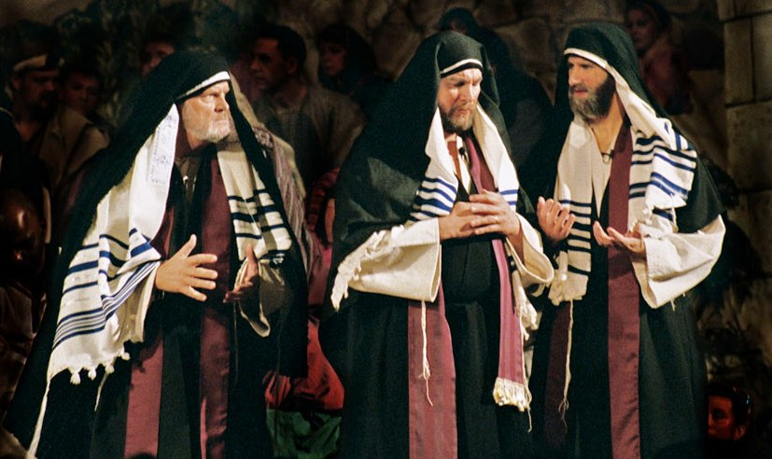
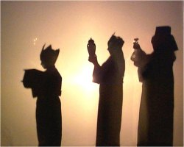


Bethlehem is only 8 kilometers
(6 miles) south of Jerusalem
Bethlehem
Close Jews
Distant Gentiles
Notes:
Only 8 kilometers from the very Son of God and they did not go to see Him!?

Slide 50
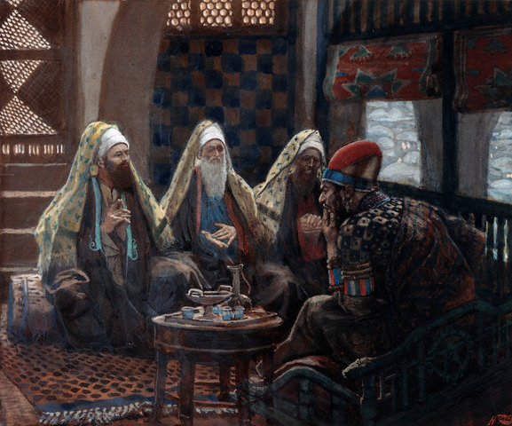
Herod pretended he wanted to worship Christ (2:7-8)
"Then Herod called for a private meeting with the wise men, and he learned from them the time when the star first appeared. ⁸Then he told them, 'Go to Bethlehem and search carefully for the child. And when you find him, come back and tell me so that I can go and worship him, too!'" (NLT)

Slide 51
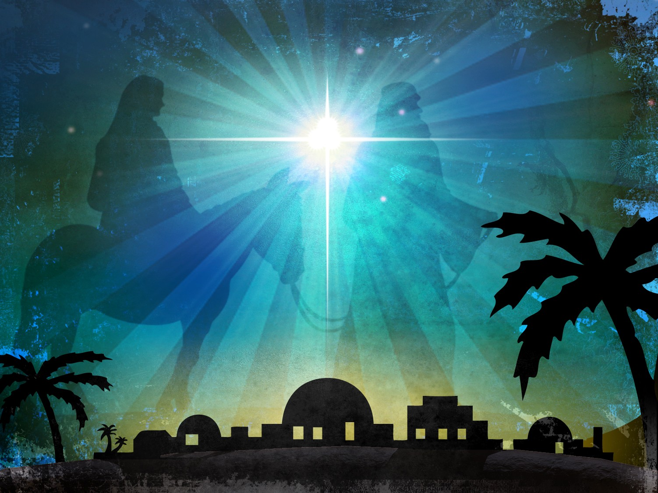
Why know the time it appeared?
Notes:
Why did Herod want to know the exact time the star had appeared? He had an evil plan up his sleeve and needed to know how old the child was at that time.
The best we can tell, the star appeared to the magi the night Christ was born, but it took them several months to leave the east and make the long trek to Jerusalem.
Did Herod want to worship Jesus? Hardly! He wanted others to do the dirty work for him of wandering around town, then when he knew the place he would destroy him.

Slide 52
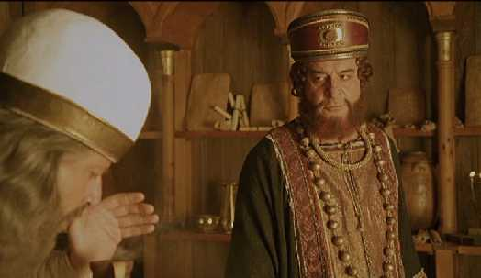
Those whom you wouldn't expect worshipped Him while those whom you would expect to welcome Him rejected Him!
Notes:
It's interesting that we have found in this passage those whom you wouldn't expect to worship Christ worship Him while the ones we would expect to be anxiously awaiting his arrival rejected Him. In our final section today we'll see the culmination of the wise men's search…

Slide 53

III. Those whom you wouldn't expect worshipped Christ (2:9-12).
Notes:
The pagan astrologers finally made it to the Christ Child and worshipped Him.

Slide 54
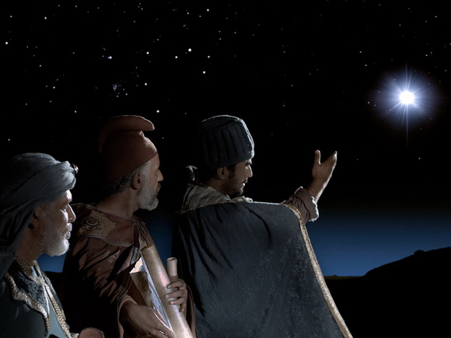
The Star Reappears!
"After this interview the wise men went their way. And the star they had seen in the east guided them to Bethlehem. It went ahead of them and stopped over the place where the child was. ¹⁰When they saw the star, they were filled with joy!" (2:9-10 NLT)
Notes:
God honored the magi's commitment to worship Christ with further guidance (2:9-10).

Slide 55
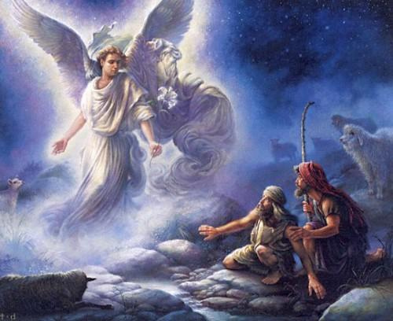
Least likely witnesses
Notes:
Luke records how the least likely candidates as witnesses—shepherds—witnessed the night of the birth.

Slide 56
The Star Reappears!
Greek:
"They rejoiced a joy great exceedingly"!
Notes:
Now Matthew shows how God made the star reappear to direct other unlikely candidates to the exact location (2:9).
The worshippers were elated when they spotted the star (2:10).
The Greek text here says literally, "They rejoiced a joy great exceedingly"!
What a thrill it is to have the Lord confirm your steps!

Slide 57
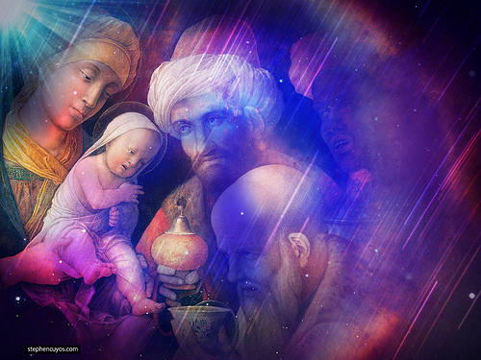
"They entered the house and saw the child with his mother, Mary, and they bowed down and worshiped him" (2:11a NLT)
Notes:
(Finally the magi's many month journey was fulfilled in verse 11 where it says that…)
The magi worshipped Christ (2:11).
They worshipped with reverent bowing (2:11a)

Slide 58
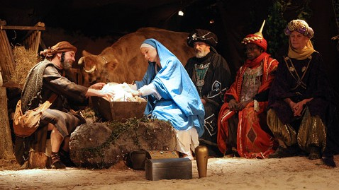
The typical nativity shows the magi at the manger
Notes:
Notice that they worshipped Christ in a house, not the manger—a good lesson on not developing your theology from Christmas cards!

Slide 59
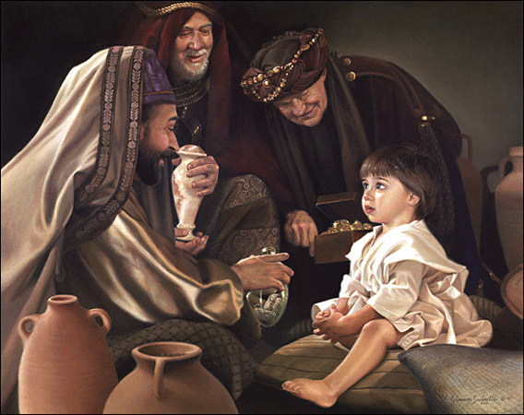
Up to 2 years later…
Notes:
Actually, he was more like a toddler up to two years old. Notice also that they worshipped the baby, not the mother. How tragic that some give Mary the worship that is due to Christ!

Slide 60
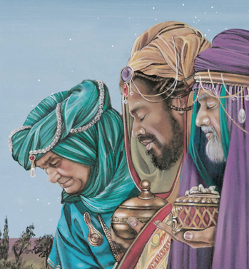
Worship with Gifts
The inferior gave to the superior
Notes:
They worshipped by giving gifts (2:11b).
Bringing gifts was a very important practice in the ancient East when approaching a superior (EBC). Imagine that! The magi recognized that this tiny baby was their superior so they opened up their treasure-boxes (or coffers) and gave the King of Kings gifts!

Slide 61

Significant Gifts:
Frankincense
Gold
Myrrh
Notes:
The gifts were expensive, but the normal gifts for royalty with great symbolism:

Slide 62


Gold
King
Notes:
Gold is the most precious metal, fit for a King.
Gold represents royalty (some say deity or purity).

Slide 63



Frankincense
Priest
Notes:
Frankincense is a glittering, odorous gum obtained by making incisions in the bark of several trees. It was used as incense.
Since priests burned incense in the temple, frankincense likely portrays Christ as our High Priest.
___________
Frankincense to ease arthritis? See http://www.biblicalarchaeology.org/daily/people-cultures-in-the-bible/jesus-historical-jesus/why-did-the-magi-bring-gold-frankincense-and-myrrh/

Slide 64



Myrrh
Savior
Notes:
Myrrh exudes from a tree in Arabia and was a valuable spice and perfume—and especially an embalming fluid.
Myrrh suggests that Christ would die a sacrificial death (since it was used to wrap bodies after death). It reminds us that Jesus is our Savior.

Slide 65
Significant Gifts:
Frankincense
High Priest
Gold
Ruling King
Myrrh
Redeeming Savior
Notes:
I wonder if the magi thought in these terms. However, it does makes sense to see these as gold depicting Christ as Ruling King, frankincense showing him as High Priest, and myrrh for his work on the cross as Redeeming Savior.

Slide 66

Money for the trip to Egypt
Notes:
But at the very least, God provided these expensive gifts for Joseph and Mary to finance their soon-to-occur unexpected trip out of the country to Egypt.
_________
"Flight into Egypt" Stewart S. Goodall - c1884

Slide 67

Return of the Wise Men
"When it was time to leave, they returned to their own country by another route, for God had warned them in a dream not to return to Herod" (2:12 NLT)
Notes:
(What an amazing thing to see these Gentile men obey the Lord's direction all the way to Bethlehem! God gave them a final way to obey, though…)
The magi obeyed God by not reporting back to Herod (2:12).

Slide 68

God's Light for Us
Notes:
As I studied the responses to Christ’s birth in this passage, the most amazing thing to me was that

Slide 69


Worship Irony!
Notes:
the Jews,
those whom you would expect to worship the infant king,
never did worship Him
• while the Gentiles,
the ones with far less of God's Word than the Jews,
ended up giving Christ his rightful homage!
• What a worship irony!

Slide 70

Responses to Jesus
Gentiles seeking
Herod opposed
Jerusalem disturbed
Leaders ignored
Notes:
The magi sought the King, Herod opposed the King, Jerusalem was disturbed about the King, and the Jewish leaders ignored the King!

Slide 71


Main Idea:
Jews ignored Him while Gentiles worshipped Him—how about you?

Slide 72

Wise Men Still Seek Him
Notes:
Christmas is filled with paradoxes—like Jews continuing to reject their Messiah while many secret believers embrace Him!
What will be your response to the King this Christmas? Wise men still seek Him!

Slide 73
Your response to Jesus?
Gentiles seeking
Herod opposed
Jerusalem disturbed
Leaders ignored
Notes:
Will you oppose the King like Herod—by allowing hindered relationships to fester in your family over the holiday season?
Will you be disturbed about the King—by looking at Christmas as the last big hassle you'll have to put up with this year?
Will you ignore the King—by celebrating a Christmas void of spiritual depth, a secular Christmas. This is easy since Satan has created so many distractions!

Slide 74

How can we worship the King?
Notes:
I have no doubt that most of us here want to really worship the King as the magi did. How do we do it, though? Two suggestions…

Slide 75

Focus traditions on Christ
Notes:
Practice family traditions centered around the person of Christ.

Slide 76

Give to someone who cannot give back
Notes:
Worship Him by giving to someone who cannot respond with a gift to give back to you—as Jesus, Joseph and Mary could never reciprocate to the wise men for their generous gifts.

Slide 77
Black
Notes:
(Optional)
Some time ago several people gathered at the home of a wealthy couple to celebrate the christening of their newborn baby. The friends mingled, talked, laughed, drank and enjoyed all the refreshments for some time in the company of family and friends.
In a passing conversation someone mentioned that he had not yet seen the baby.
"The baby!" the mother exclaimed and rushed into the bedroom, only to see that the baby, which had been left on the huge bed, had been buried under the pile of coats.
The baby had suffocated under the heavy weight and laid dead on the bed.
The one for whom those people came to celebrate suffocated due to their selfish neglect (WORSHIP neglected and replaced with distractions).

Slide 78


NT Preaching link at BibleStudyDownloads.org
Get this presentation and script for free!
Notes:
NT Preaching (np)

